Slide 1
Snapdragon
DCN Lab: Experiment 4
T.Dharani(1818113)
K.Sowndarya(1818153)

Slide 2
ECHO CLIENT SERVER IMPLEMENTATION USING UDP
Aim:
To write a python program for Echo client-server
communication using UDP connection.

Slide 3
Procedure –Server side:
Step1:Import socket module so that we can us socket to receive messages along with address from the client.
Step2:Create a server socket.
Step3:Bind the socket with specified ip address and the port number which carries the message
sent by the client.
Step4:Wait until the datagram arrives from client. At this stage ,”server is waiting “ will be displayed.
Step5:Once the message is received along with its address, message will be decoded and gets dispayed
along with address.
Step6: Now the message is encoded into bytes in server side and sent back to the client
using send to function.This is possible by echoing.

Slide 4
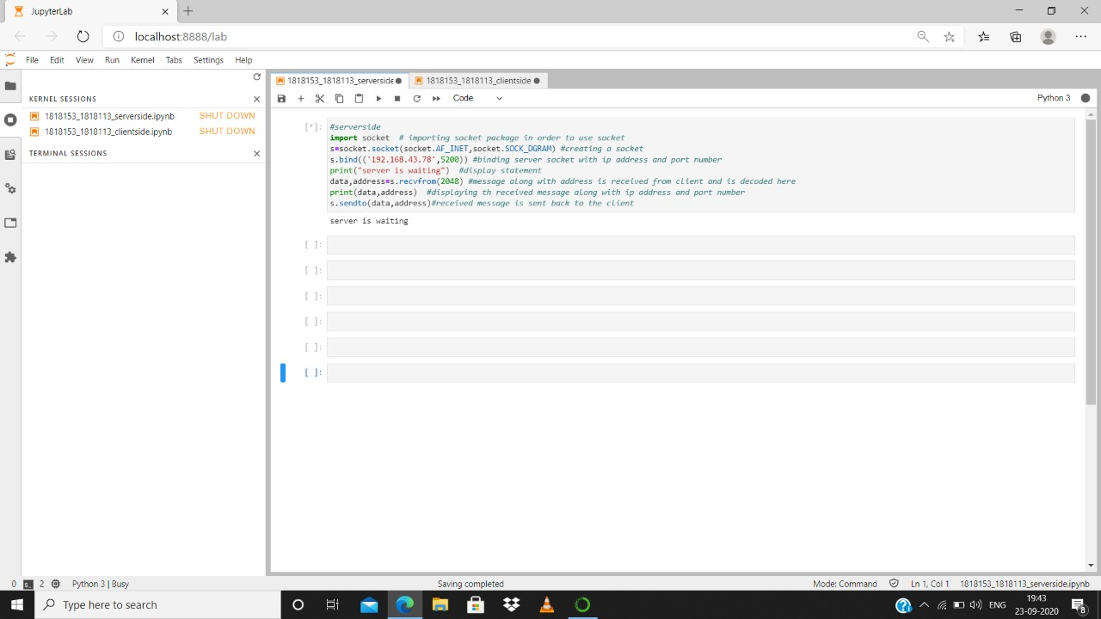

Slide 5
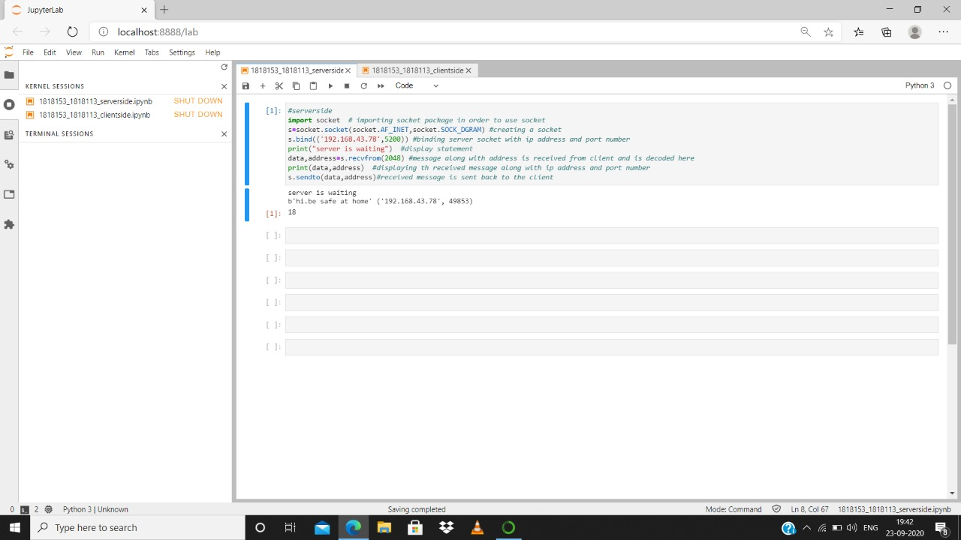

Slide 6
Procedure – Client side:
Step1:Import socket module to use socket to send messages along with address to the server.
Step2:Create UDP socket.
Step3:Use a variable to get the input ((i.e) the message to be sent to the server) from
the user.
Step4:Using sendto() function the encoded message in byte format along with its address
is sent to server.
Step5:Now using recvfrom() function get back the message sent to the server.
Step6:Print the data and address received from server.

Slide 7
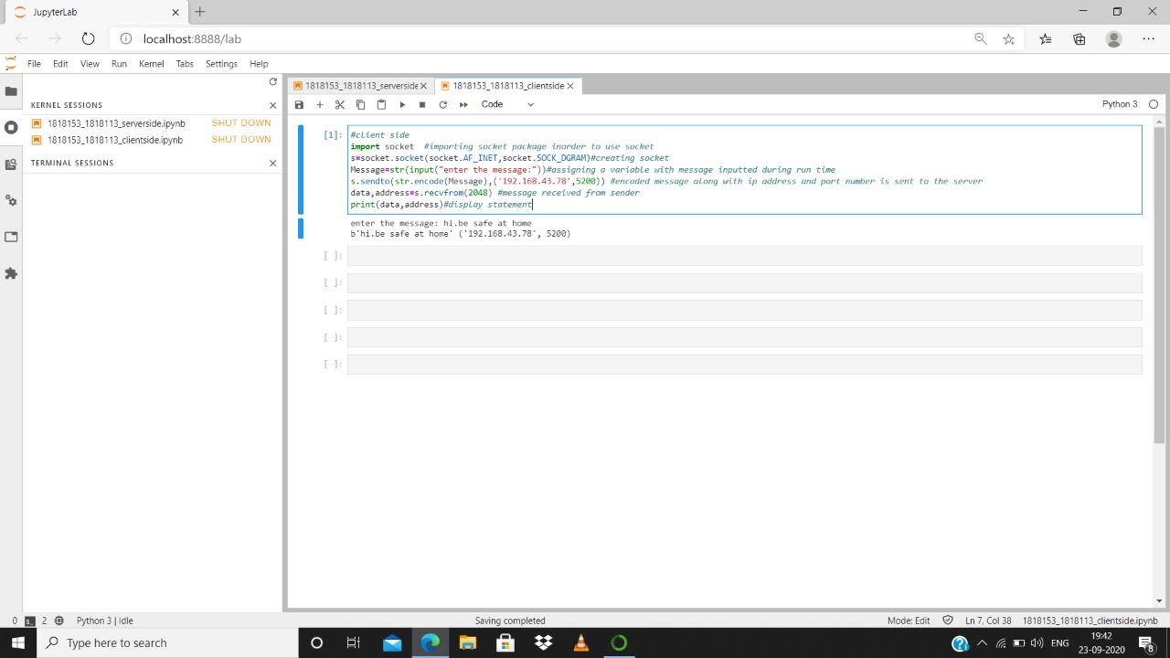

Slide 8
Result: Thus the python program for Echo client- server communication using UDP connection is implemented successfully.

